Slide 1
Capturing Facial Expressions through COTS mmWave Radar
Supervisor: Prof. Sandip Chakraborty
Mentored By: Mr. Argha Sen
Submitted By: Amrta Chaurasia (19EE10004) BTP-1 Avijit Mandal (18CS30010) MTP-1
Notes:
speaker notes

Slide 2
Introduction

Slide 3
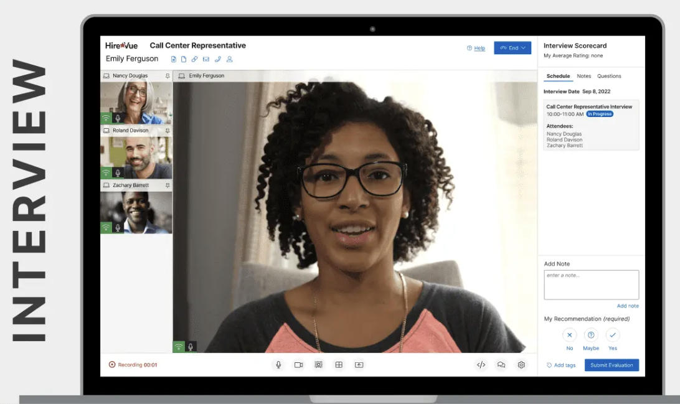
Importance of Facial Expression
Understand real-time audience feedbacks
Predict psychotic disorder or depression related issues
Identify uninterested candidates during interview
Important development towards Human Computer Interaction
Credits: HireVue

Slide 4
Modalities of Recognition

Slide 5
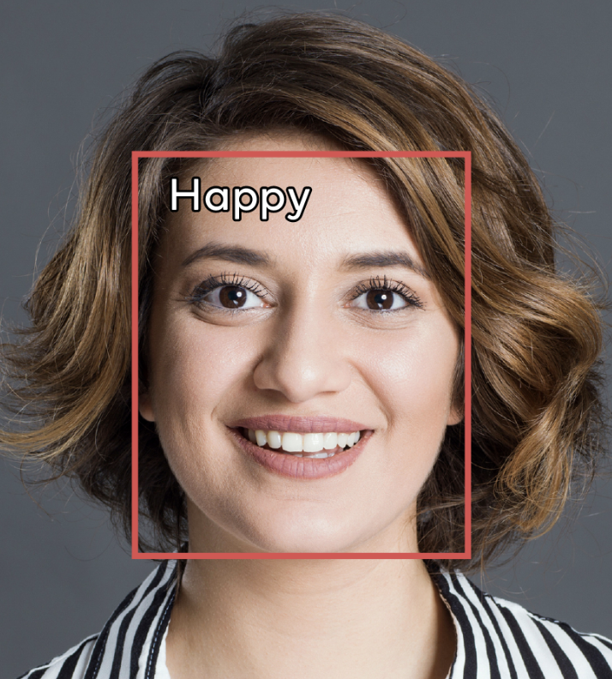
Camera based
Pros
Easy setup and cheap hardware components
Widely available datasets for training
Cons
Surveillance camera raise privacy concern
Highly depends on lighting conditions
Facial Occlusion, eg Sunglasses, Scarves.
Enacted training Datasets, different from natural.
Notes:
Surveillance cameras may raise privacy concerns, especially at home and office environments. Moreover, camera-based sensing is highly dependent on the environmental lighting conditions, making it hard to work under conditional of low illumination, smoke, and opaque obstructions. In contrast, acoustic-based sensing does not have privacy issues with images and is deployable in less favorable conditions.

Slide 6
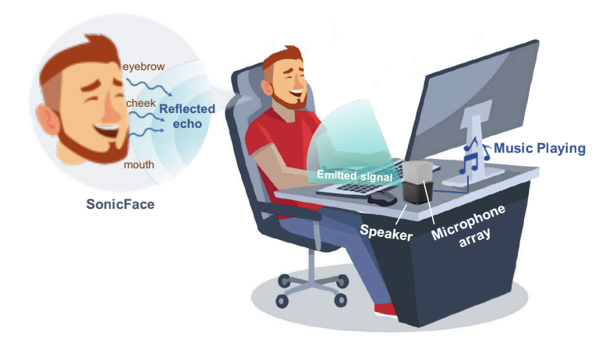
Signal based Sensing
Non-intrusive and less privacy concern
Independent of environmental conditions
Guarantee security in locations where video recording is not allowed
Can work in a range of distance without even requiring a direct line of sight.
Two broad types:
Acoustic Sensing
RF sensing
Notes:
Non-intrusive and less privacy invading method compared to camera.
Independent of environment factors such as: poor lighting conditions, obstructions (such as mask, cloth, accessories, etc.), smoke etc.
Can guarantee security in locations where video recording is not allowed such as toilets or lockers.
It can add a variety of intelligent functions to automatic doors, by detecting the presence of people and indicating their movement direction. There with radar saves energy consumption at the same time.
can work within a distance from a few centimeters to a few hundred meters and operate without a direct line of sight (for example, through drywall or plywood).

Slide 7
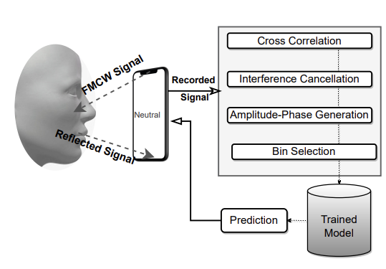
Acoustic Sensing
Pros
Cheaply available setup, even on commercial phones
Range resolution of ~4.3 cm. Good for motion detection
Cons
Range resolution not effective for facial expression detection.
Phase resolution technique not effective due to high λ
Accuracy achieved 56.7 % (low)

Slide 8
2. RF Sensing
WiFi sensing
Lower bandwidth (80 MHz), giving low range-resolution (~ 1.8 m).
CSI based approach doesn’t work well for multi-user scenarios.
mmWave sensing
Better range resolution (~0.0375m) due to higher bandwidth (4 GHz).
High wavelength ensures higher phase resolution
FMCW based approach, enables us to utilize phase resolution info.
EM wave unlike acoustic waves doesn’t face any interference from background noises (other signal sources).
Notes:
CSI Channel State Information (Wifi) multi user sc

Slide 9
Violating Phase Variance
As the λ in mm range, a typical
Δr 0.63μm can induce ΔΦ around 0.057 deg.
ΔΦ ＝ 2πΔr／λ
where ΔΦ is the phase variation
Δr is change in position
λ is wavelength

Slide 10
Literature Survey
No. | Paper Title | Author | Conference/Journal | Problem Statement | Solution Proposed
1 | SonicFace: Tracking Facial Expressions Using a Commodity Microphone Array | Li et. al. | IMWUT ‘21 | Measuring facial expression using microphone array | The core idea lies in exploiting non-linearities in microphone hardware.
2 | Mask Does Not Matter: Anti-Spoofing Face Authentication using mmWave without On-site Registration | Xu et. al. | Mobicom ‘22 | Face authentication using mmWave sensing to avoid attacks possible in present authentication methods | 3 face images are collected online to form facial model which is compared to data collected by mmWave device used onsite for authentication.

Slide 11
Literature Survey
No | Paper Title | Author | Conference/Journal | Problem Statement | Solution Proposed
3 | EchoPrint: Robust Human Face Authentication Leveraging Acoustic Sensing on Smartphones | Zhou et. al. | IEEE TMC ‘22 | Making a robust authenticating system for commodity smartphones using camera (visual) and acoustic signals (sound). | Registration phase where the front camera detects the facial landmarks while the speaker sends acoustically signals to capture acoustic features.
4 | BlinkListener: “Listen” to Your Eye Blink Using Your Smartphone | Liu et. al. | IMWUT ‘21 | Camera based blinking detections suffers from privacy concerns, strict lighting conditions, and line-of-sight requirement. | Authors first quantitatively model the relationship between signal variation and the subtle movements caused by eye blink and interference.

Slide 12
Methodology

Slide 13
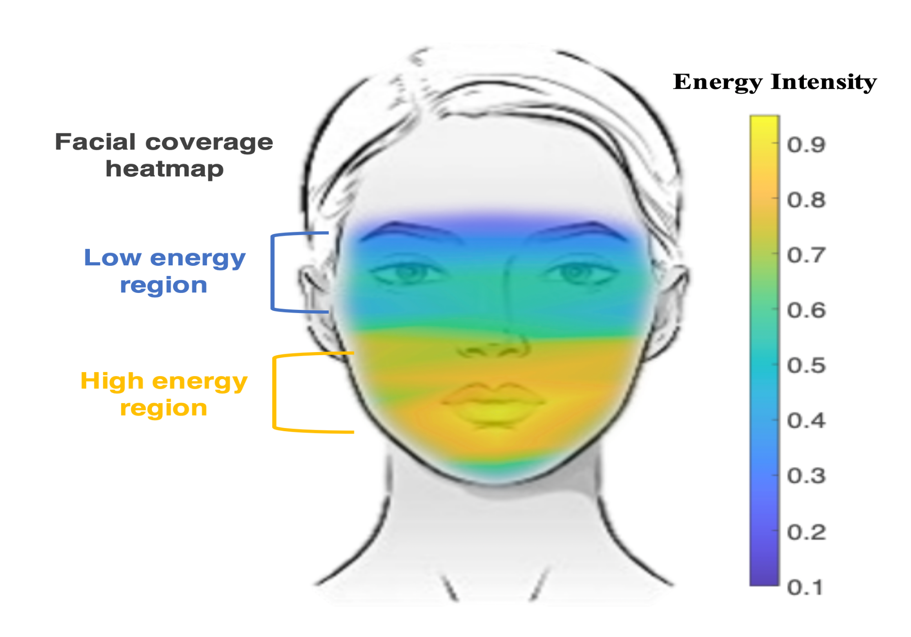
Facial Expressions
The mouth and cheek regions exhibit relatively higher energy intensity compared to the eye and eyebrow regions, where the weak muscle movements are observed.
Credits- SonicFace: Tracking Facial Expressions Using a Commodity Microphone Array (https://dl.acm.org/doi/10.1145/3494988)
Notes:
As we know from SonicFace

Slide 14
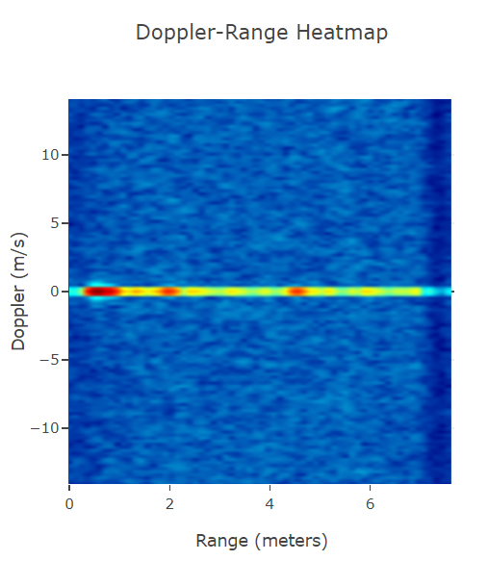
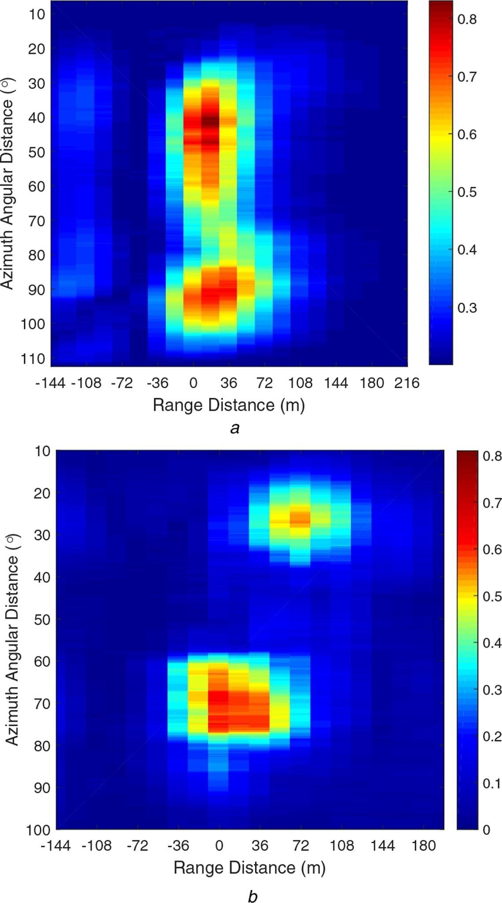
Azimuth, Elevation and Range-Doppler
Azimuth: Angular measurement, spherical coordinate systems, Horizontal domain
Elevation: Angular measure, spherical coordinate systems, Vertical domain
Range-Doppler: a 2D heat-map whose ordinate is Doppler and abscissa is Range which gives information of user movement across different range bins
Azimuth Angular Distance
Range
Elevation Angular Distance
Range

Slide 15
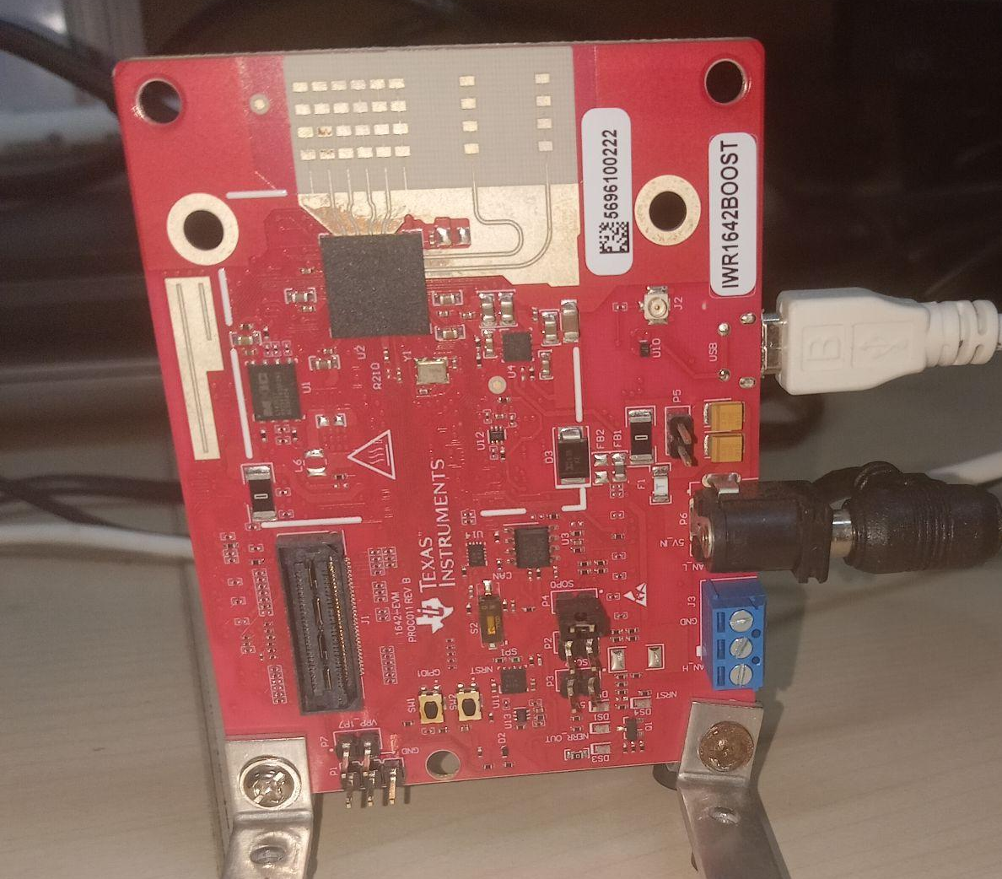
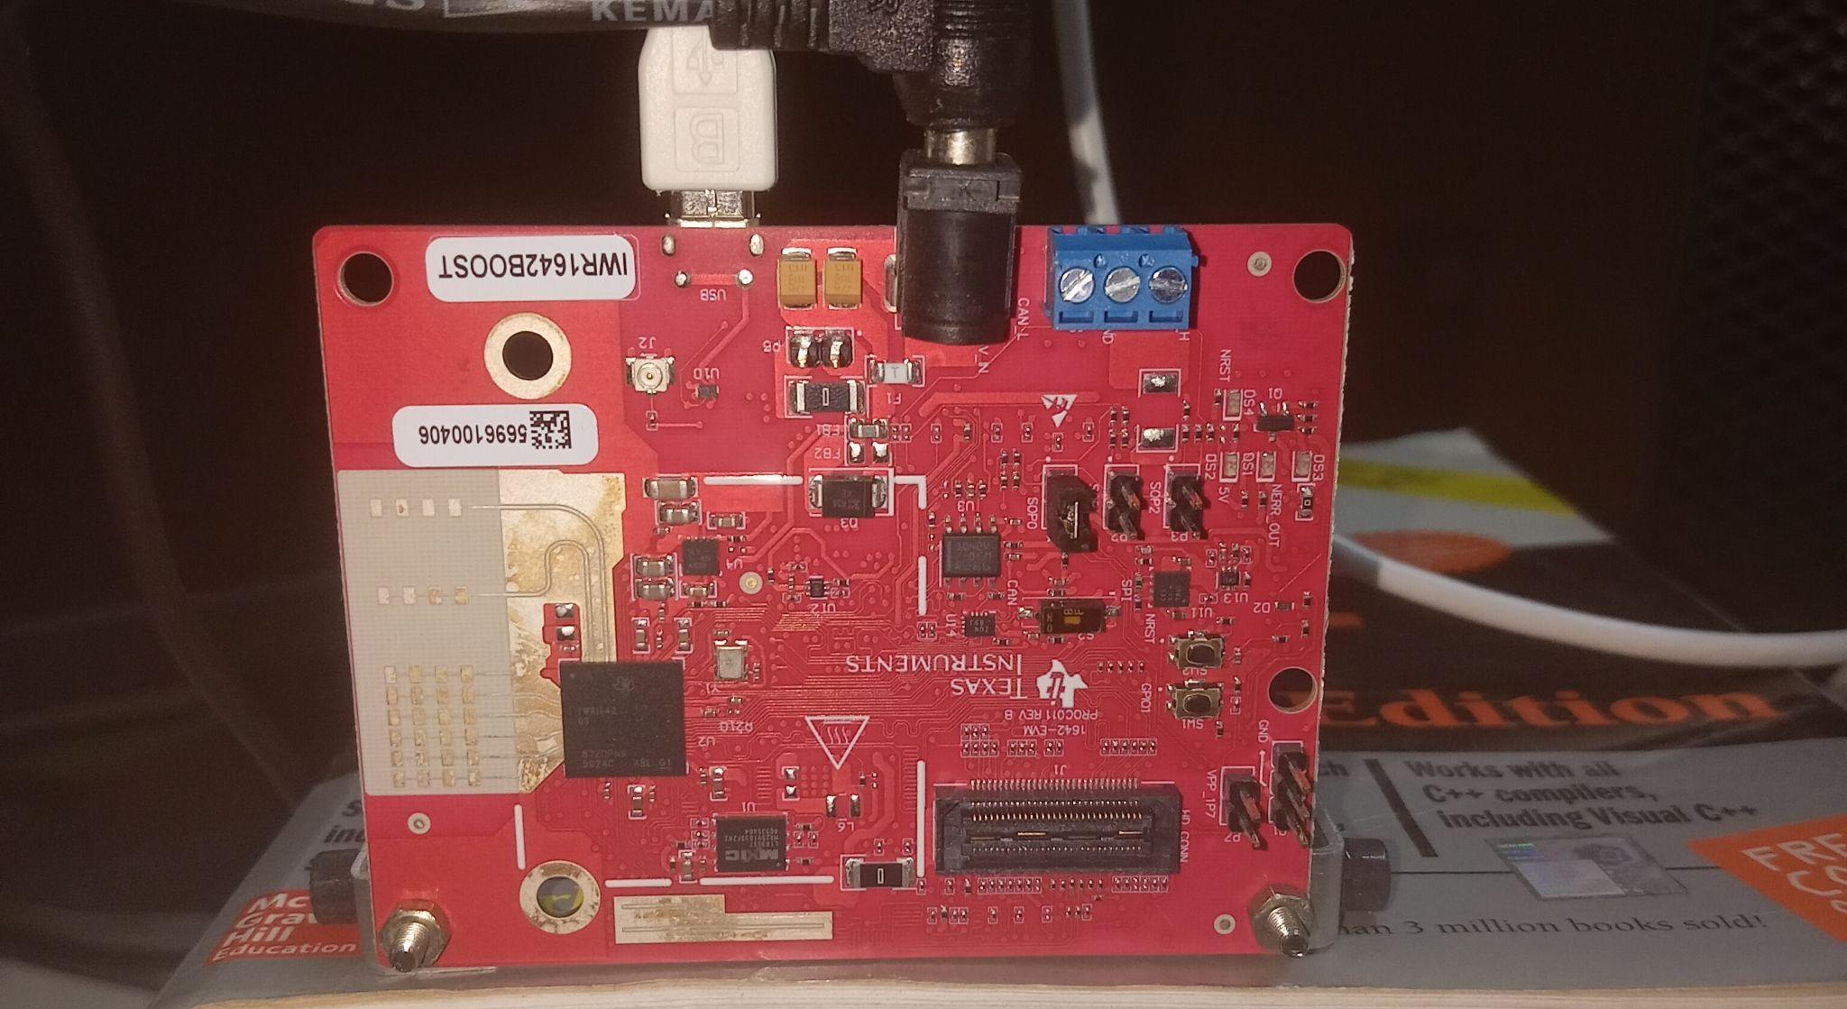
Facial Expression Recognition using mmWave Radar (IWR1642BOOST)
To capture range-azimuth and range-elevation heatmap we placed the sensor perpendicularly as shown.
Using the given setup, we explore the variation in mmWave data under different facial expressions.

Slide 16
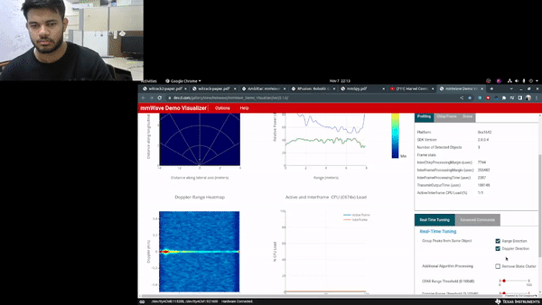
Static User No Facial Expression
Under normal facial expression there is no variations observed in the range-doppler.

Slide 17
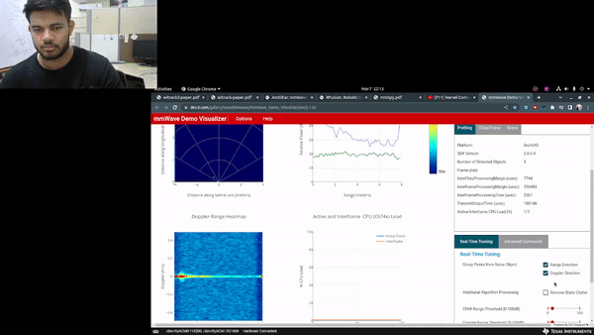
Head Motion
Range-Doppler patterns change from -0.4m/s to 0.4m/s
Coarse-grained motion such as Eye blinking, finger motion or hand movements have a doppler variation in the range of 0.5m/s to -0.5m/s

Slide 18
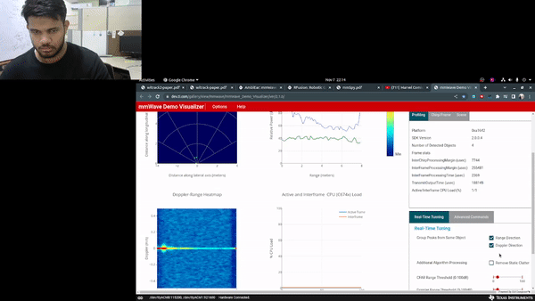
Expression Transition
Transition in the facial expression can be captured using the range-doppler patterns.
But constant smile, or constant facial expression can not be classified from the collected data.

Slide 19
Challenges with single mmWave radar
Both range-azimuth and range-elevation (3D reflected signals coming from the face) are not supported by a single radar with planar antennas.
On-chip processing on the mmWave radar supports only Pointcloud, Range-FFT, and Range-Doppler computation and adds processing latency.

Slide 20
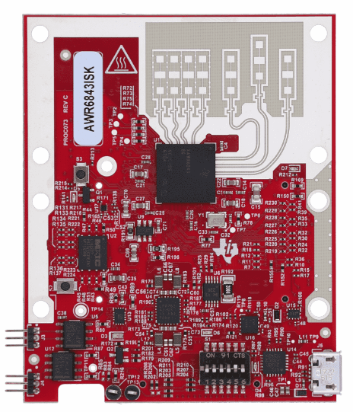
Need for AWR6843ISK Board
With this board we can collect horizontal as well as vertical plane variations.
The antennas are not coplanar as shown.
Thus, range-azimuth and range-elevation can be captured simultaneously.
Notes:
non-planar

Slide 21
Need for DCA1000EVM board
Currently using single mmWave radar, we have 4 FPS as supported by the USB baud rate (250ms for each frame).
DCA board enable capturing of High-Volume Raw ADC data using ethernet cable.
Provides with flexibility to process data as per the requirements.
We need a processing pipeline

Slide 22
Processing Pipeline

Slide 23
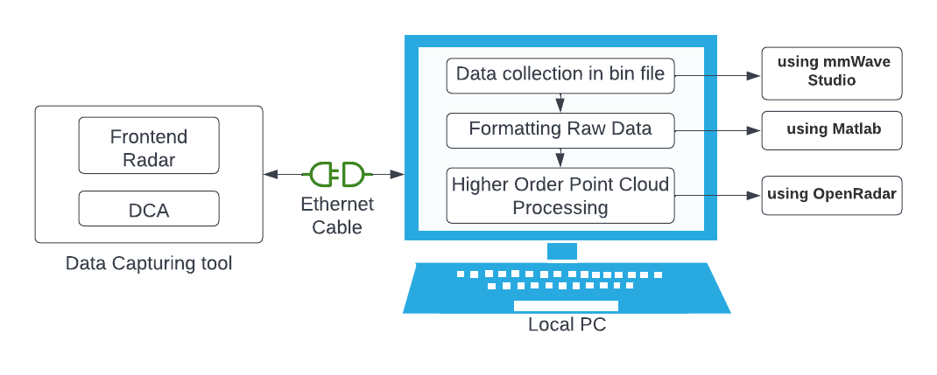
Pipeline

Slide 24
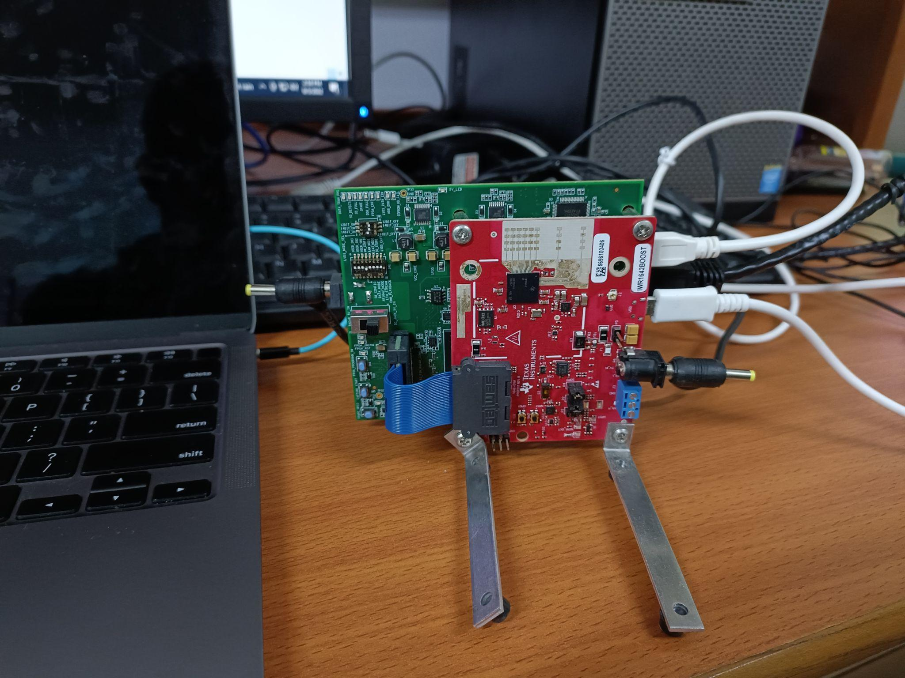
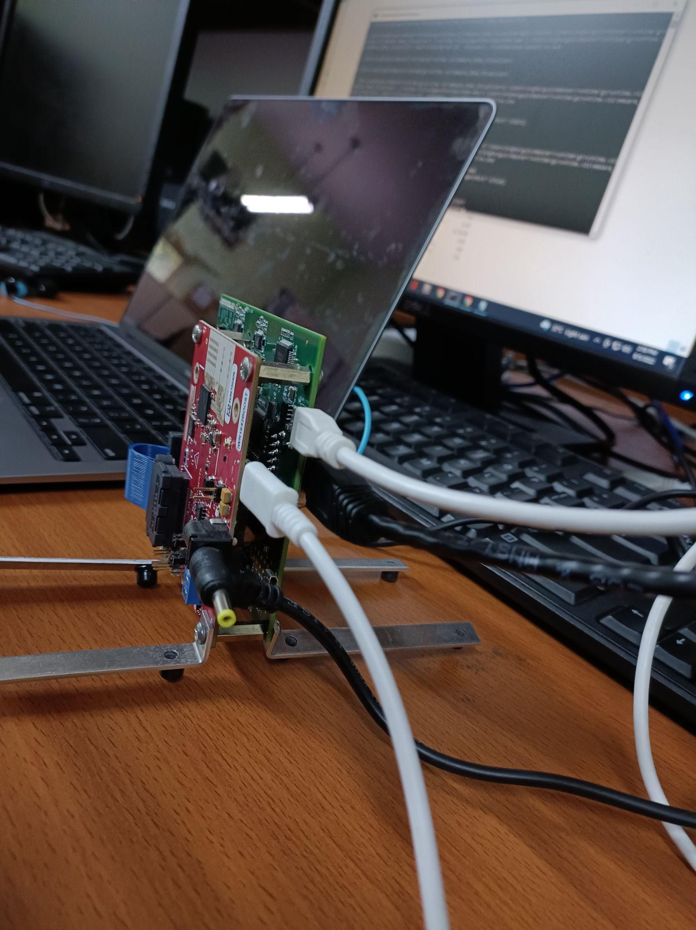
Hardware Setup

Slide 25
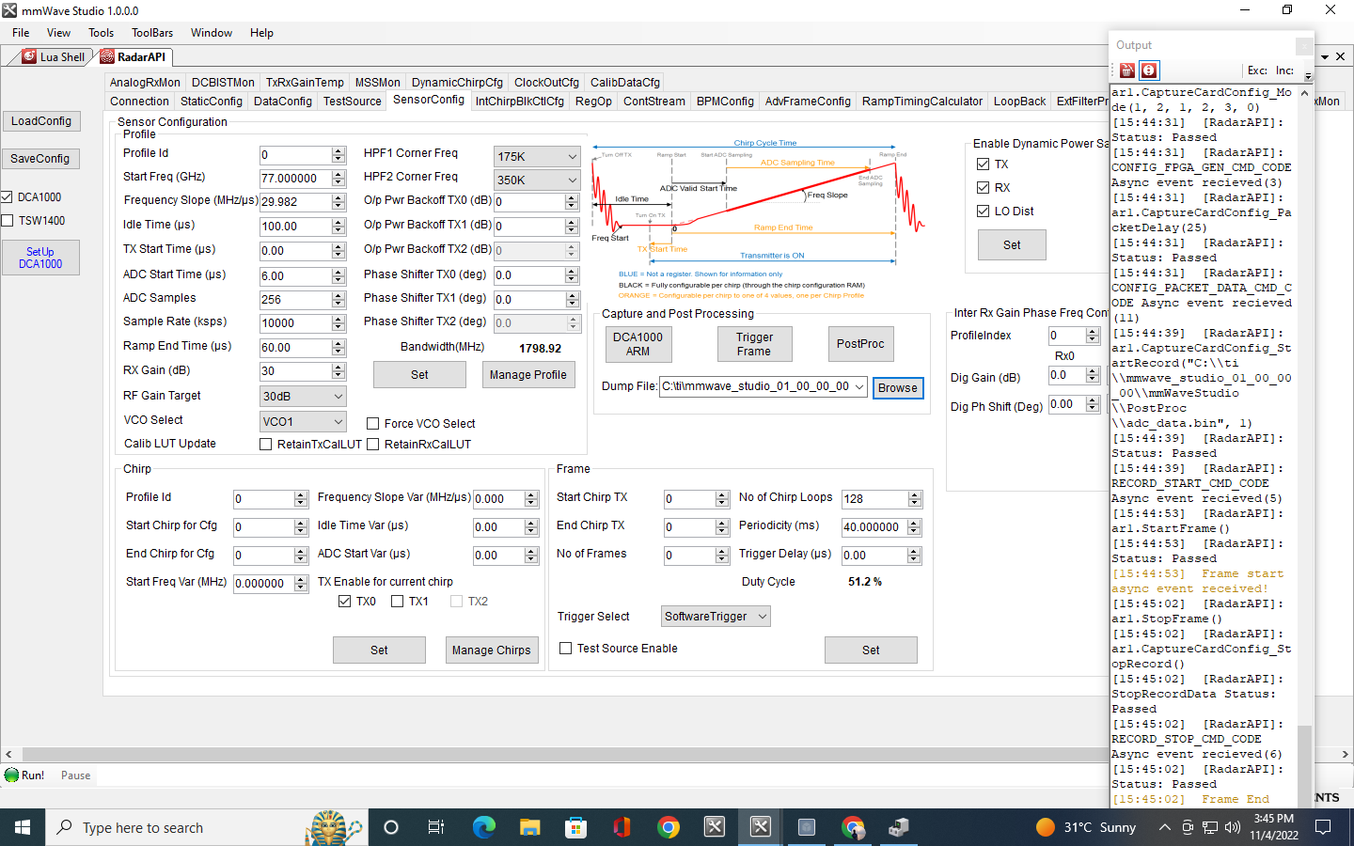
mmWave Studio Setup
Post Processing

Slide 26
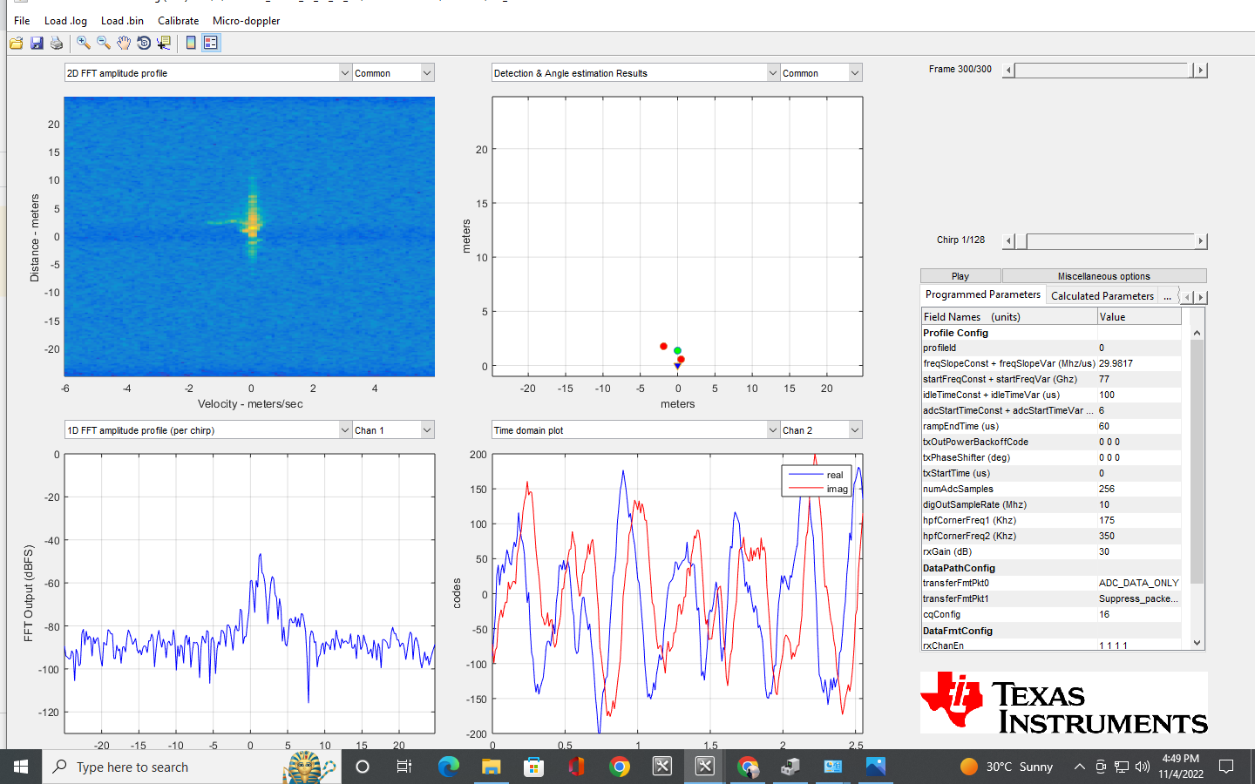
mmWave Studio Setup
Post processed data on mmWave studio

Slide 27
Pre-processing raw ADC data using MATLAB
Hyper Parameters known from mmWave Studio:
Number of ADC samples (numADC)
Number of RX antennas (numRX)
Number of chirps per frame (numCPF)
Read the raw ADC data from .bin file generated by mmWave Studio using MATLAB script.
Store the data in a .mat file as an array of dimension: [numChirps , (numADC * numRX)] where numChirps = numCPF * numFrames
Use this .mat file as input to python Scripts (OpenRadar) to visualize.
Notes:
Processing pipeline

Slide 28
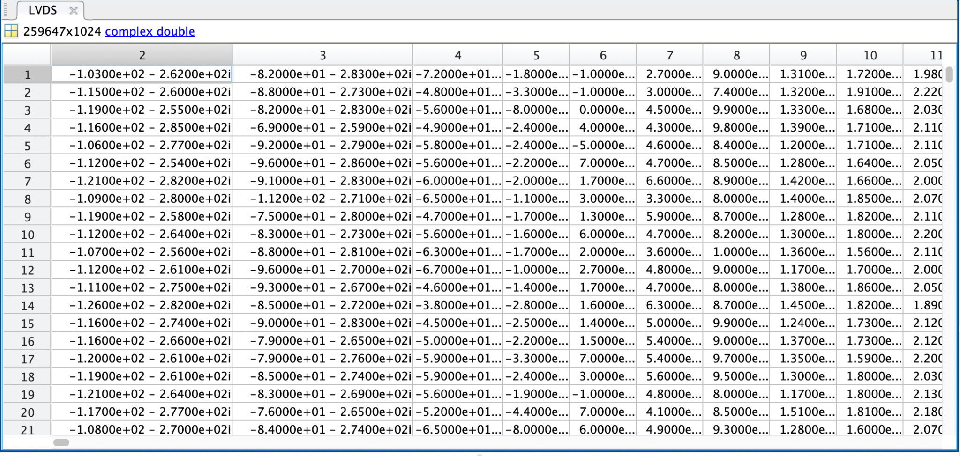
ADC data

Slide 29
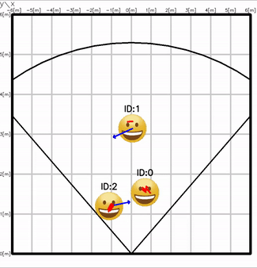
Point Cloud information using OpenRadar
pip install openradar
It applies range and doppler processing on top of raw adc data
We can use this platform for further signal processing to gain range azimuth, range elevation heatmap.
OpenRadar (https://github.com/PreSenseRadar/OpenRadar)

Slide 30
Implementation
Challenges

Slide 31
Connecting single mmWave radar with DCA board
mmWave studio setup
no guide for mmWave studio 2.0 – hit and trial. Long waiting duration to get an reply from TI forum
initially time frame was fixed, we modified for infinite time
Still we are unable to absorb the complete bandwidth
The data in bin files from mmWave studio required pre-processing in order to visualize the captured motion using publicly available tools for which we had to write MATLAB Script to obtain data in a matrix.
We modified and implemented few publicly available repos to obtain required heatmaps, which failed as were very specific to their use. We even created issues and mailed but all went unanswered.
Finally found OpenRadar library which we are currently modifying to fit our data input and provide output to match our requirements.
No publicly available dataset.

Slide 32
Future Work

Slide 33
Adjust hyper parameters in “Sensor Config -> Profile” such that we are utilizing the entire 4GHz bandwidth for data capturing with enhanced range resolution.
Fine tune data pre-processing pipeline.
Collecting data for different facial expression
Training ML/DL model on Range doppler, Range Azimuth and Range Elevation heatmap for detection of facial expression.

Slide 34
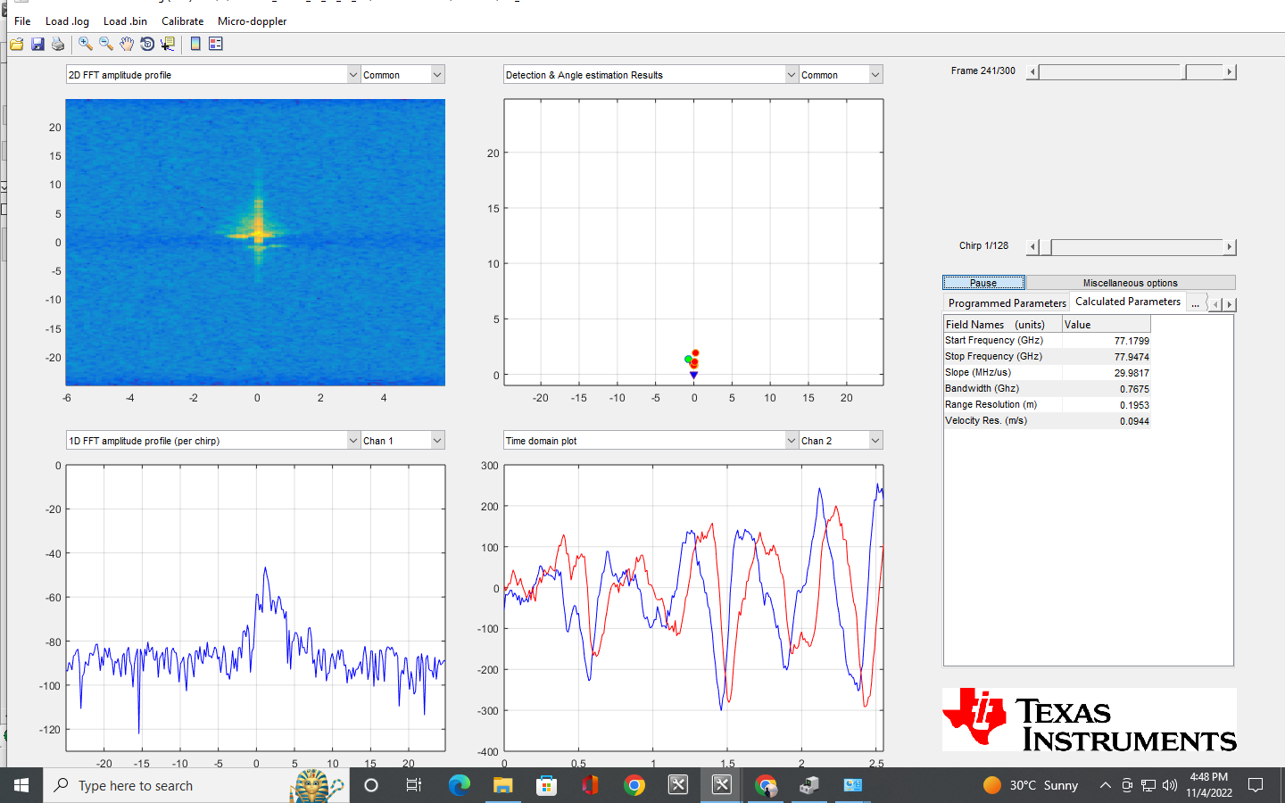
Not able to utilize entire bandwidth

Slide 35
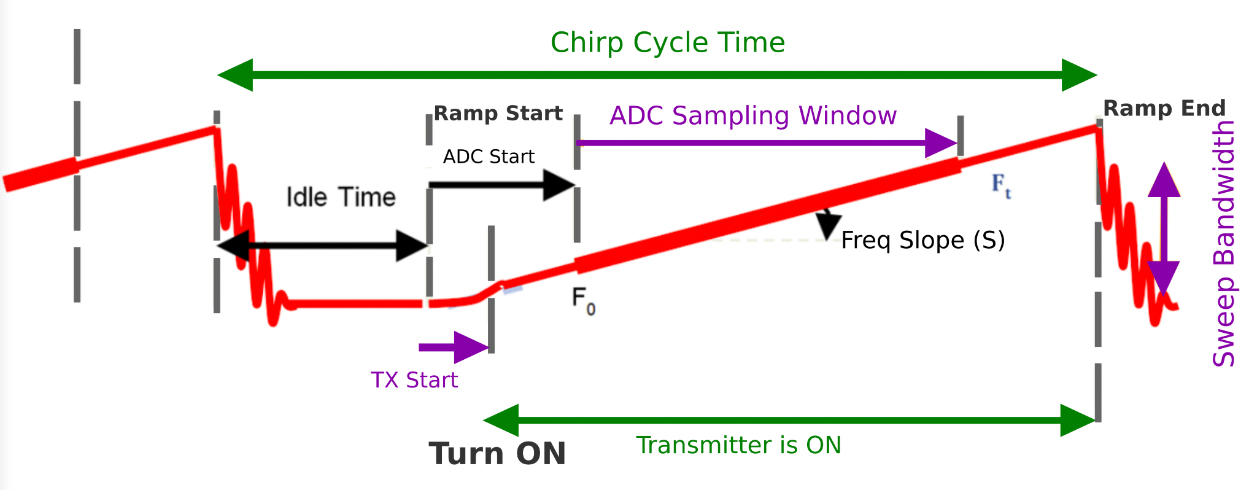

Slide 36
References
[1] Gao, Y., Jin, Y., Choi, S., Li, J., Pan, J., Shu, L., Zhou, C., and Jin, Z. (2021). Sonicface: Tracking facial expressions using a commodity microphone array. Pro- ceedings of the ACM on Interactive, Mobile, Wearable and Ubiquitous Technolo- gies, 5(4):1–33.
[2] Liu, J., Li, D., Wang, L., and Xiong, J. (2021). Blinklistener: ” listen” to your eye blink using your smartphone. Proceedings of the ACM on Interactive, Mobile, Wearable and Ubiquitous Technologies, 5(2):1–27.
[3] Pan, E., Tang, J., Kosaka, D., Yao, R., and Gupta, A. (2019). Openradar. https://github.com/presenseradar/openradar.
[4] Xu, W., Song, W., Liu, J., Liu, Y., Cui, X., Zheng, Y., Han, J., Wang, X., and Ren, K. (2022). Mask does not matter: anti-spoofing face authentication using mmwave without on-site registration. In Proceedings of the 28th Annual International Conference on Mobile Computing And Networking, pages 310–323.
[5] Zhou, B., Xie, Z., Zhang, Y., Lohokare, J., Gao, R., and Ye, F. (2021). Robust human face authentication leveraging acoustic sensing on smartphones. IEEE Transactions on Mobile Computing.

Slide 37
Thank You

Slide 38
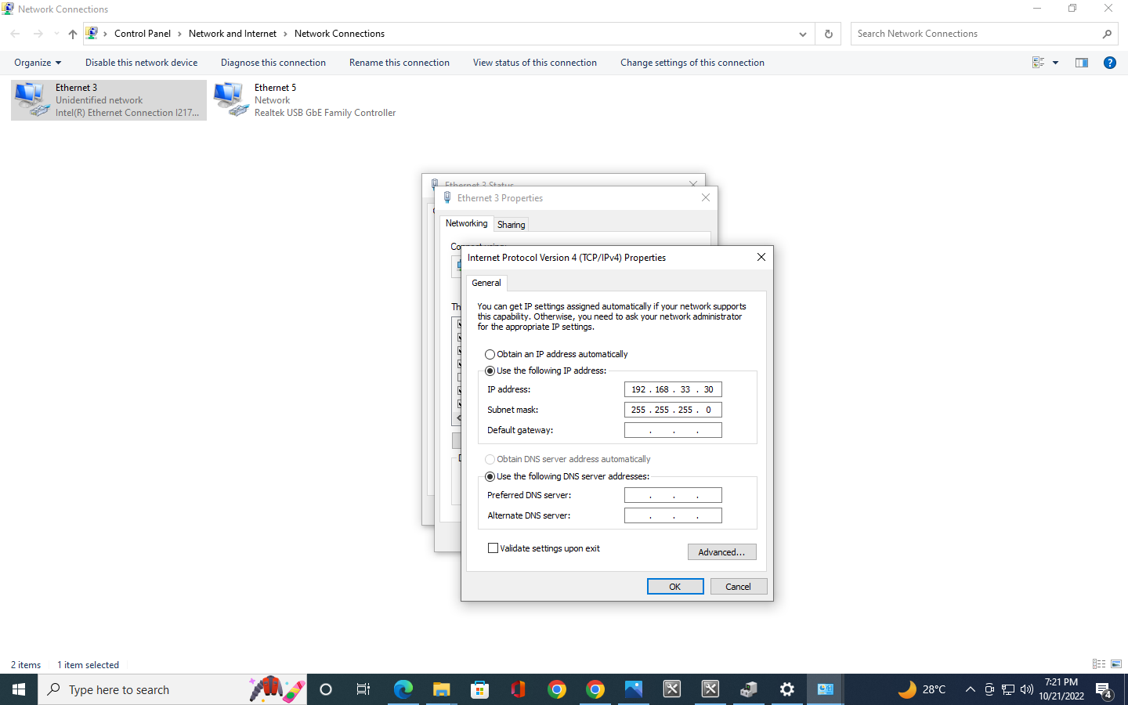
mmWave Studio Setup
IP Configuration

Slide 39
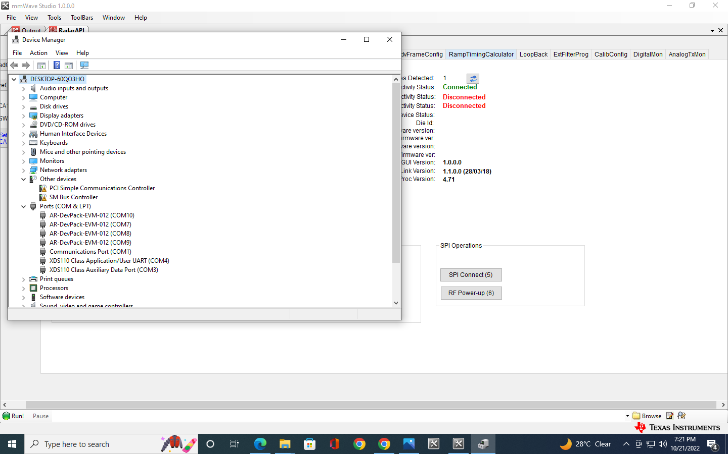
mmWave Studio Setup
Port Details

Slide 40
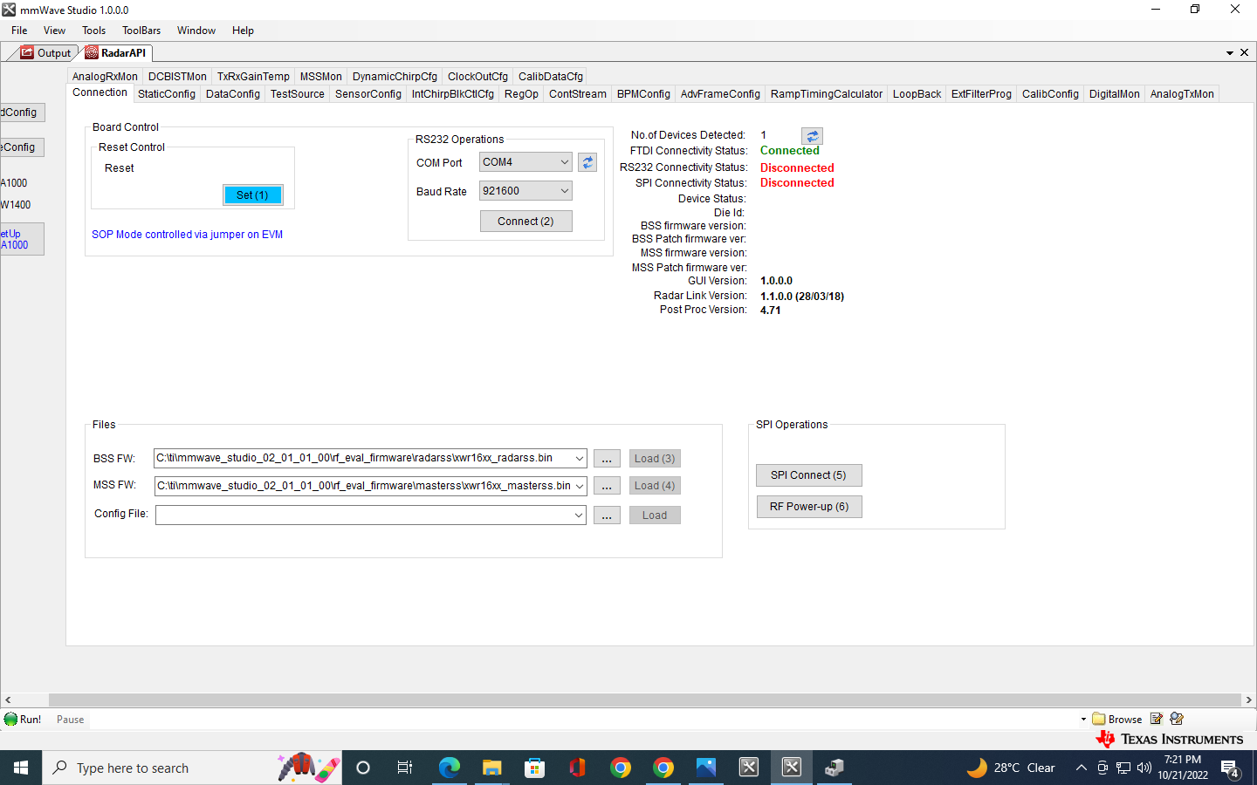
mmWave Studio Setup
Connection Setup

Slide 41
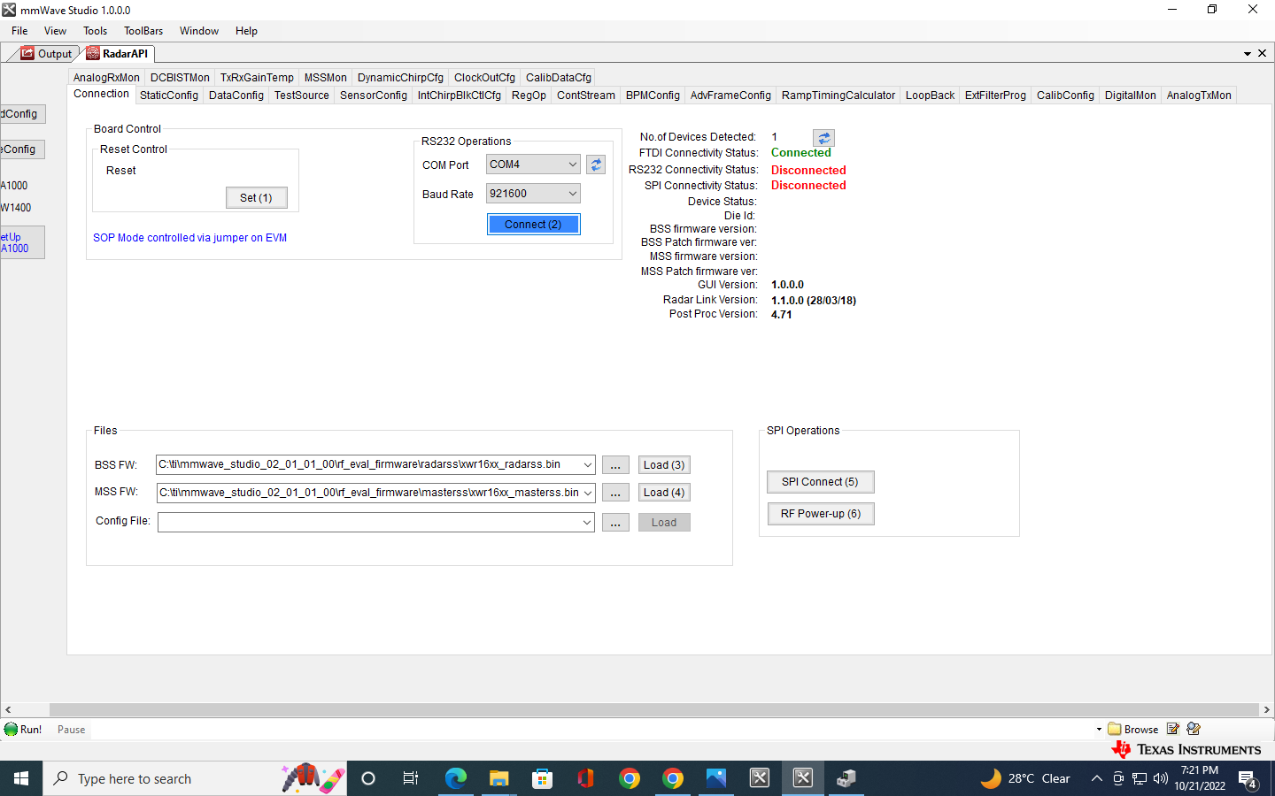
mmWave Studio Setup
Connection Setup

Slide 42
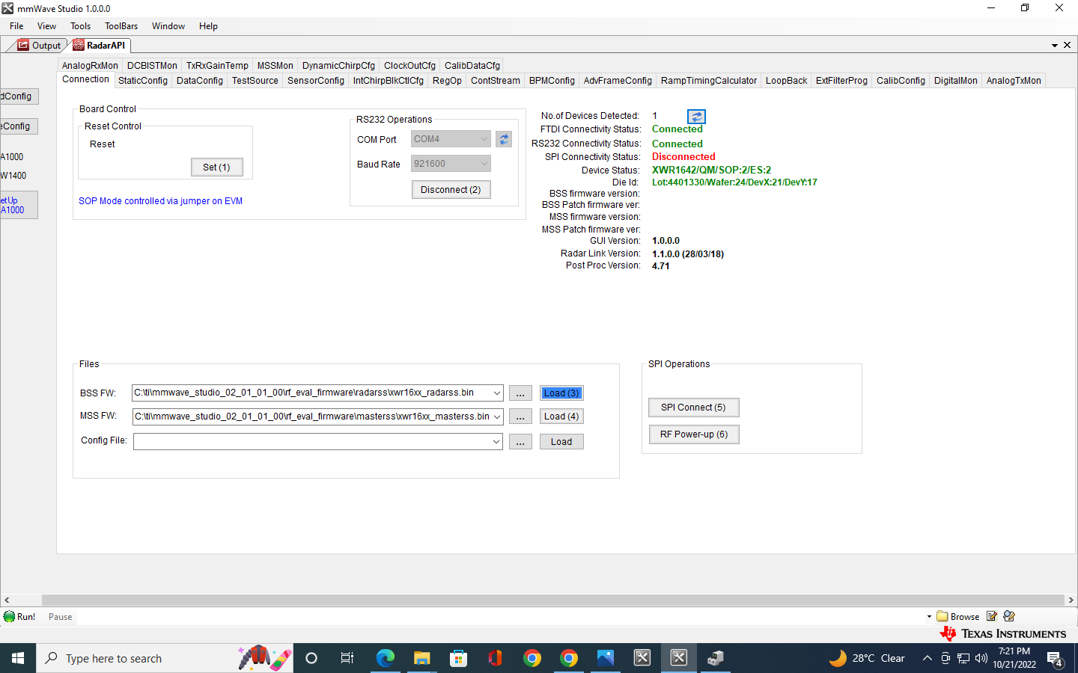
mmWave Studio Setup
Connection Setup

Slide 43
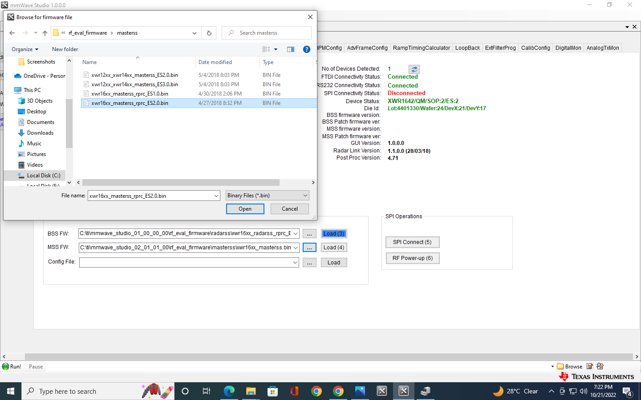
mmWave Studio Setup
Image Description

Slide 44

mmWave Studio Setup
Connection Setup

Slide 45
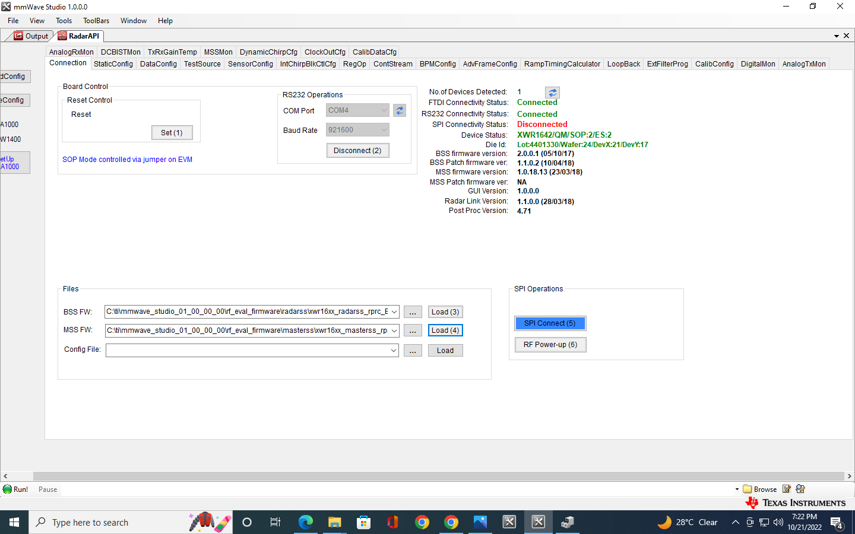
mmWave Studio Setup
Connection Setup

Slide 46
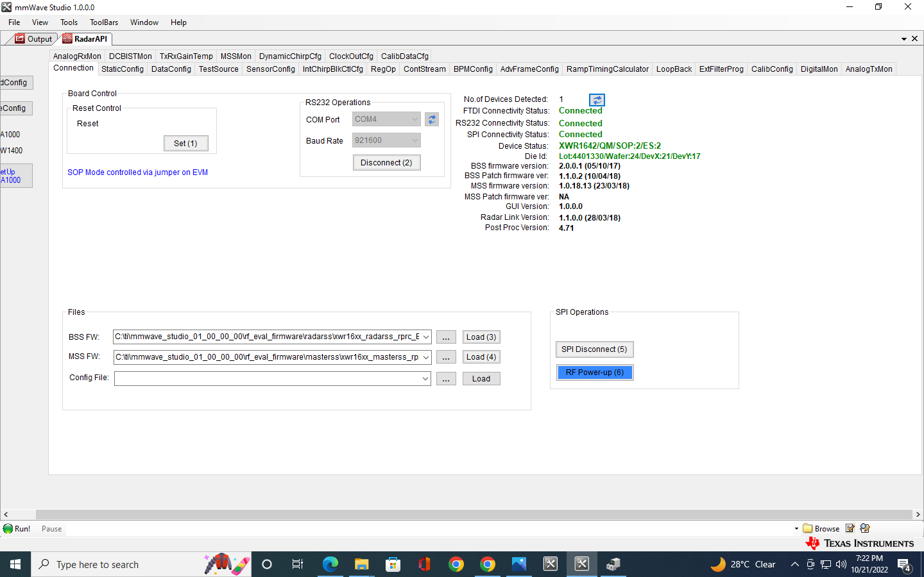
mmWave Studio Setup
Connection Setup

Slide 47
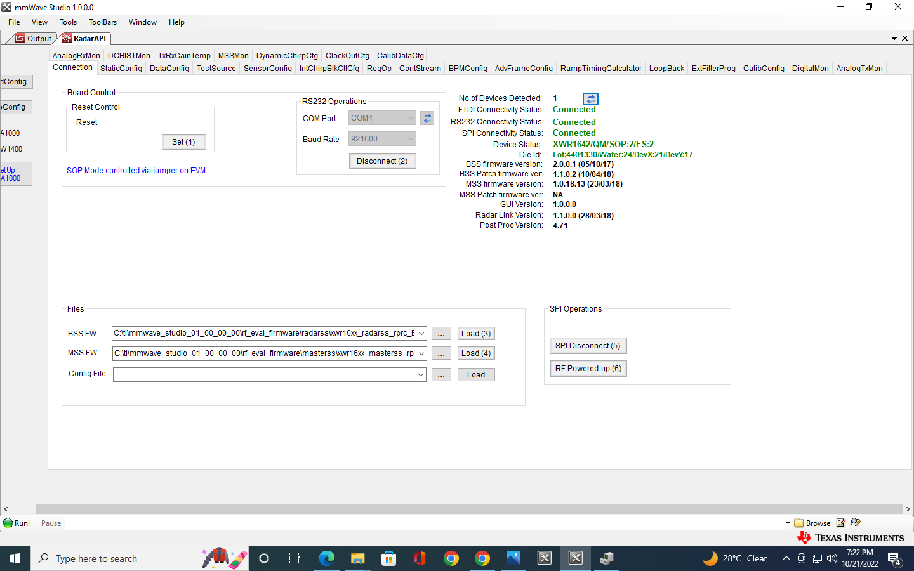
mmWave Studio Setup
Connection Setup

Slide 48
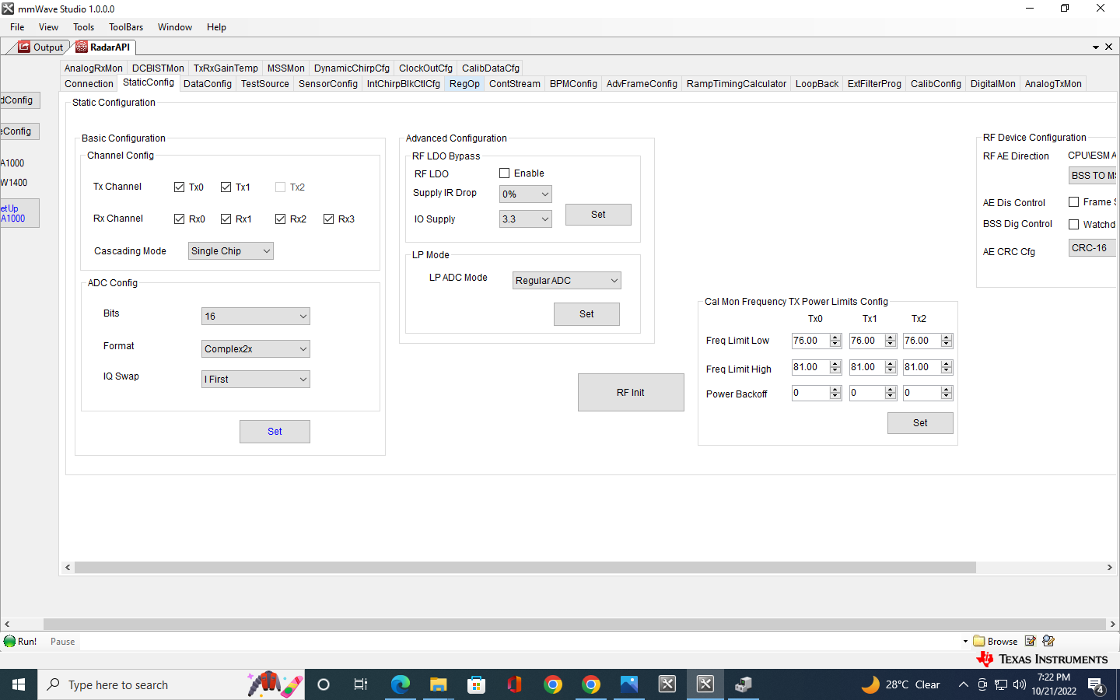
mmWave Studio Setup
2
1
3
StaticConfig Setup

Slide 49
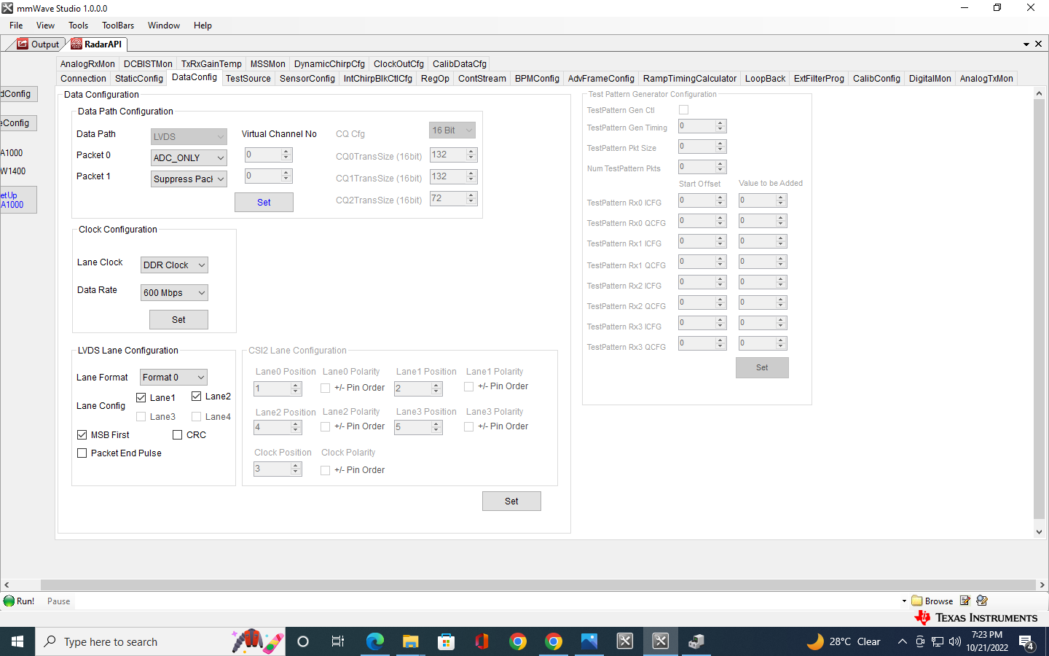
mmWave Studio Setup
1
2
3
DataConfig Setup

Slide 50
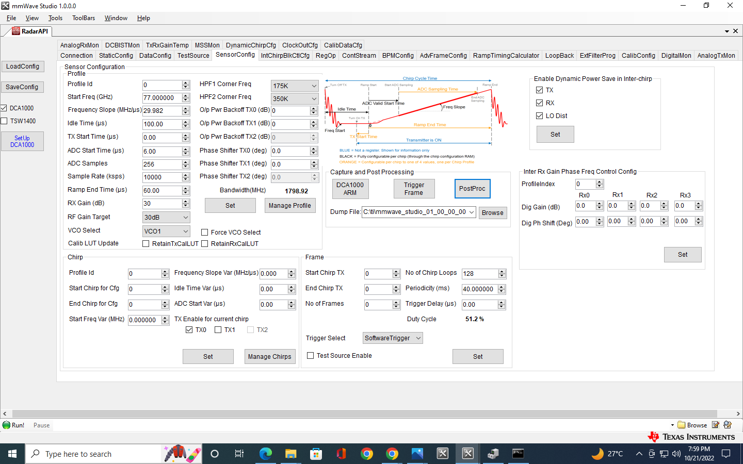
mmWave Studio Setup
4
1
2
3
SensorConfig Setup

Slide 51
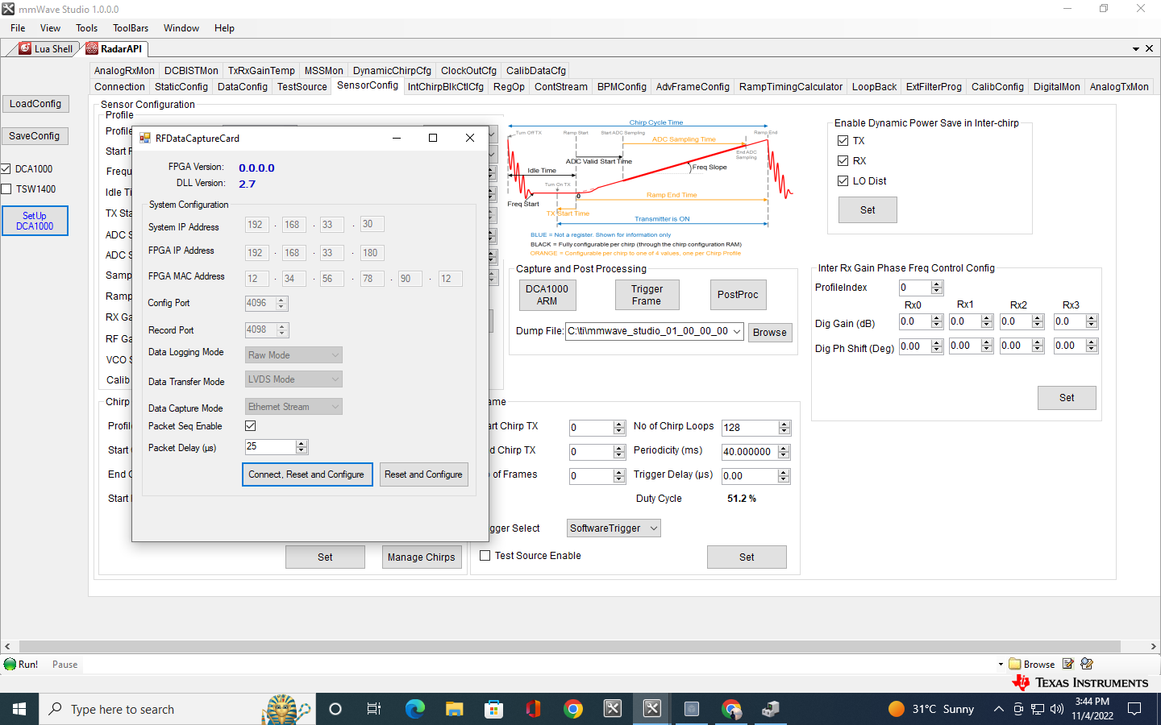
mmWave Studio Setup
RFDataCapture Config

Slide 52
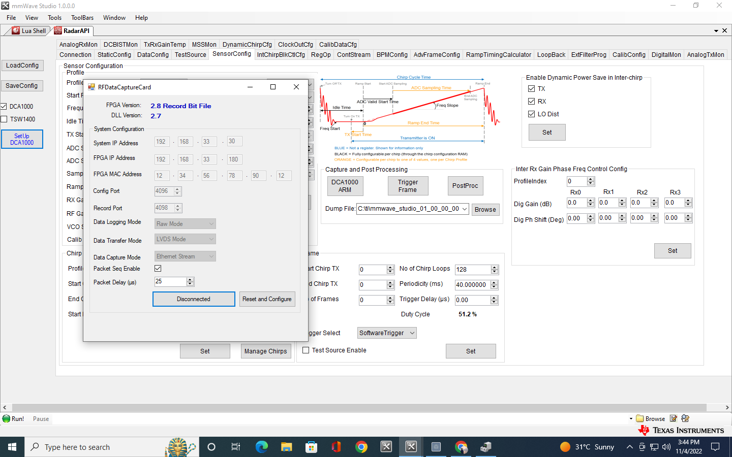
mmWave Studio Setup
RFDataCapture Config

Slide 53
mmWave Studio Setup
Capture and Post Processing

Slide 54
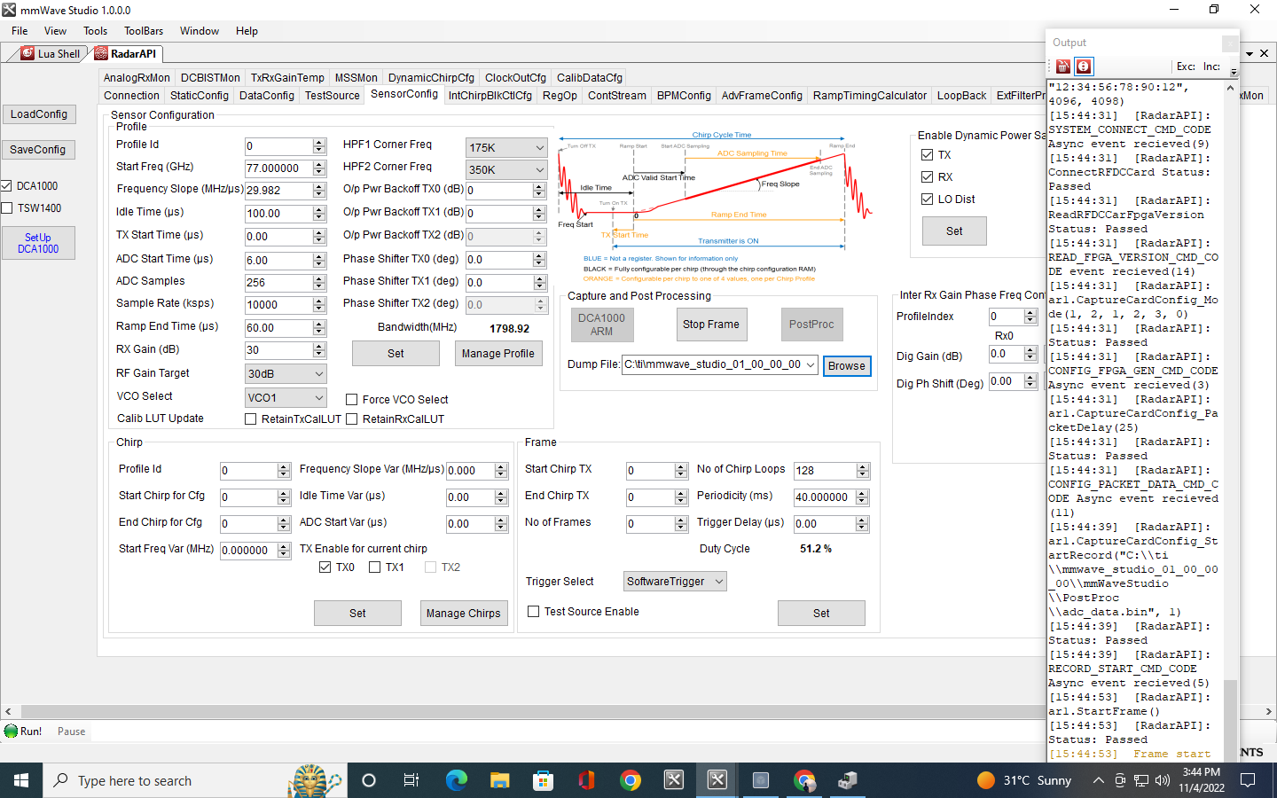
mmWave Studio Setup
Stop Capturing data

